Slide 1
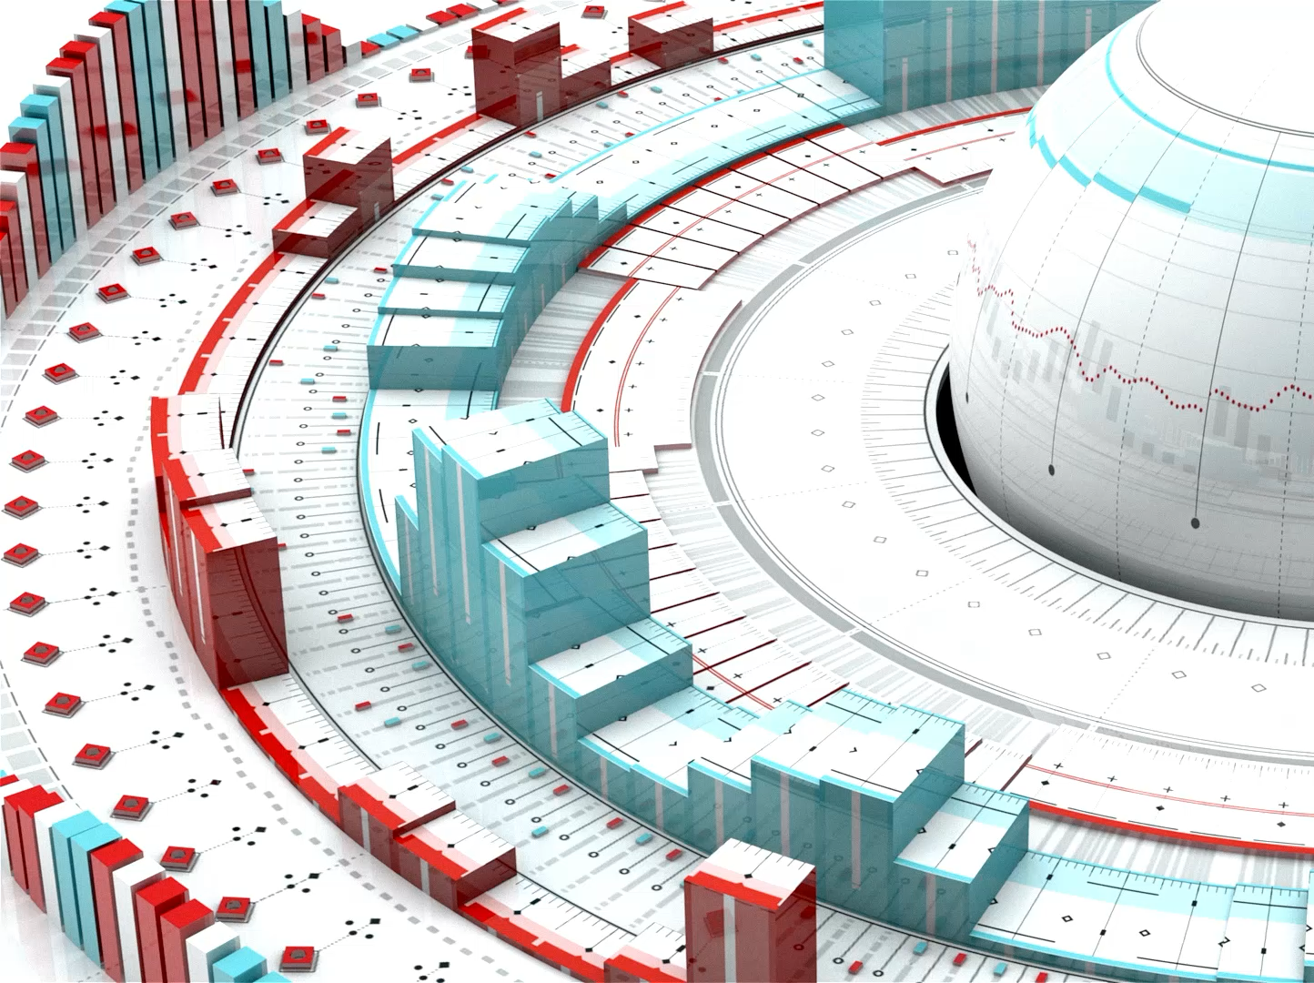
AI Labs Demo Walkthrough
Using PyTorch, and Hugging Face

Slide 2

High-Level Overview
Lab Environment Setup Guide
https://youtu.be/HFmxLaRJrwE?si=ZzsEINcsDes5BHeq
Hugging Face is an open-source platform with pre-trained AI models ready to use.
Learning with basic examples gives you the hands-on experience needed to build real-world solutions.
These small experiments teach you the same processes, workflows, and tuning techniques you’ll apply in full-scale business applications.
Your real-world problems may be larger — but the process you use to solve them will be the same.
Notes:
🤖
What is AI?
Artificial Intelligence (AI) refers to the ability of computers or machines to simulate human intelligence. This includes:
Learning: Acquiring knowledge and patterns from data.
Reasoning: Making decisions or solving problems.
Perception: Interpreting input like vision, speech, or text.
Interaction: Engaging with humans through natural language or robotics.
🔍 Examples:
Chatbots (like ChatGPT)
Self-driving cars
Fraud detection systems
🧠
PyTorch
PyTorch is an open-source deep learning framework developed by Meta (Facebook). It’s widely used for building and training neural networks.
🔥 Key Features:
Dynamic computation graphs: More intuitive for debugging and experimentation.
Tensor operations: Similar to NumPy but with GPU acceleration.
Autograd: Automatic differentiation for backpropagation.
TorchScript: For deploying models in production.
🛠️ Common Use Cases:
Image classification
Natural language processing
Reinforcement learning
🤗
Hugging Face Transformers
Hugging Face is a company that maintains the Transformers library—a powerful open-source collection of pretrained models for:
NLP (Natural Language Processing): Text generation, sentiment analysis, translation
Vision: Image classification, object detection
Multimodal: Text + image models
📦 Key Benefits:
Pretrained models: No need to train from scratch.
High-level APIs: Easy to load models with one line of code.
Support for multiple frameworks: Works with both PyTorch and TensorFlow.

Slide 3
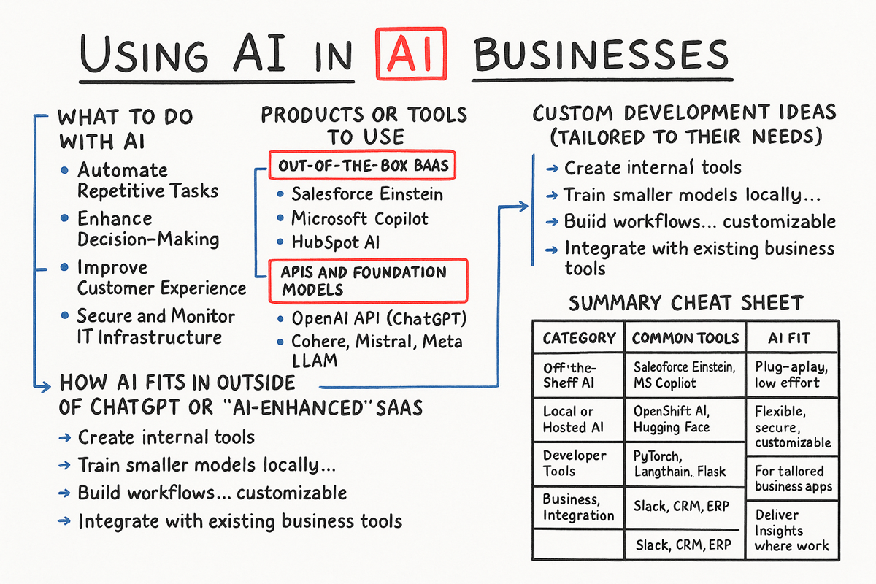

Slide 4
Lab Breakdown
📄 File | 🔍 Purpose
explore_csv_data.py | Load and analyze CSV data, show stats, plot histograms and correlations
image_classification_torchvision.py | Classify an image using a pretrained ResNet-18 model from torchvision
sentiment_analysis_hf.py | Run sentiment analysis using Hugging Face Transformers
text_generation_gpt2.py | Generate text from a prompt using GPT-2
train_custom_dataset.py | Build, train, and evaluate a model on a synthetic dataset using PyTorch
train_spam_detector.py | Training and saving fine tuned model
spam_classifier.pth | Using fine tuned model

Slide 5

WSL Environment Update
Switch to your virtual environment
Install git
Install these libraries:
Transformers --- Pretrained NLP models interface
Pandas --- Data analysis and manipulation
Matplotlib --- Create charts and graphs
Pillow --- Image processing and editing
Requests --- Send HTTP web requests
torch, torchvision, torchaudio
git clone https://github.com/mcropsey/ai-huggingface-labs
python3.11 -m pip install torch torchvision torchaudio transformers pandas matplotlib pillow requests

